Slide 1

Solstice Medical
Group
PALLIATIVE MEDICINE & WOUND CARE CLINIC + HOME HEALTH, HOSPICE AND PALLIATIVE CARE

Slide 2

Home Wound Care Services Salt Lake City
Struggling to access professional home wound care services in Salt Lake City? Solstice ensures you receive the highest level of care right at home. Our skilled nurses specialize in advanced wound treatments to promote healing while prioritizing your comfort and recovery. Let us support you on your journey to better health.

Slide 3

Wound Care Center Salt Lake City
Looking for expert wound care in Salt Lake City? Solstice’s wound care center offers specialized treatments tailored to your needs. Our team focuses on effective healing and preventing complications, providing a supportive environment where your care is our priority. Count on us for advanced care and personalized attention.

Slide 4
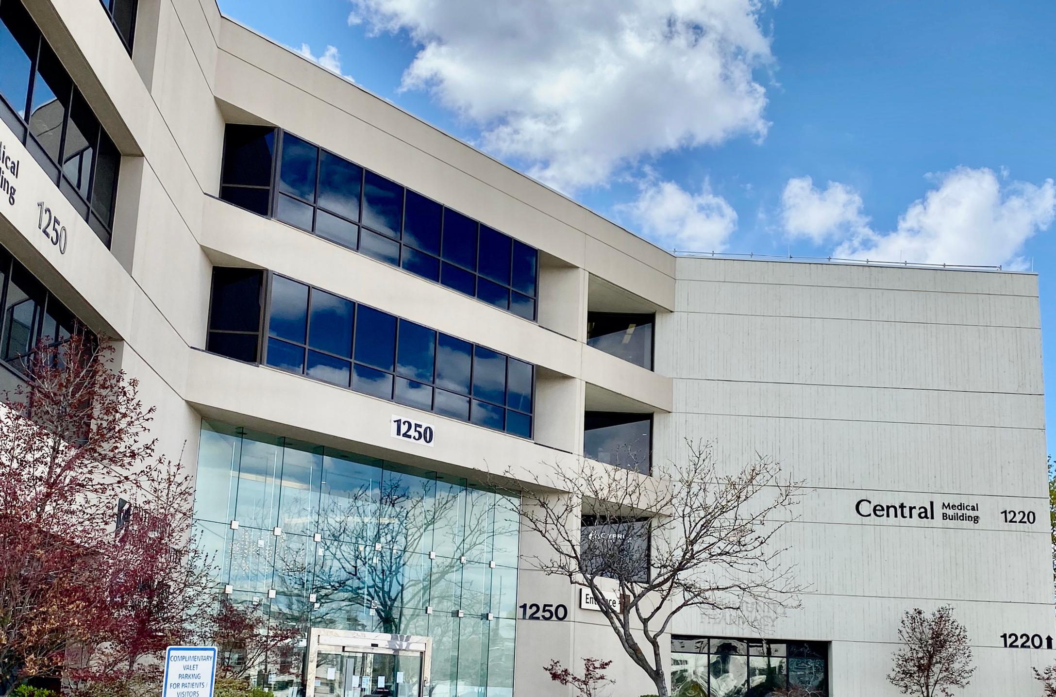
Outpatient Wound Care Clinic Utah
Searching for an outpatient wound care clinic in Utah? Solstice provides specialized treatments to manage wounds effectively. Our expert team is committed to helping you heal faster, using advanced techniques and personalized care plans. Let us support your recovery with professional care designed for your needs.

Slide 5
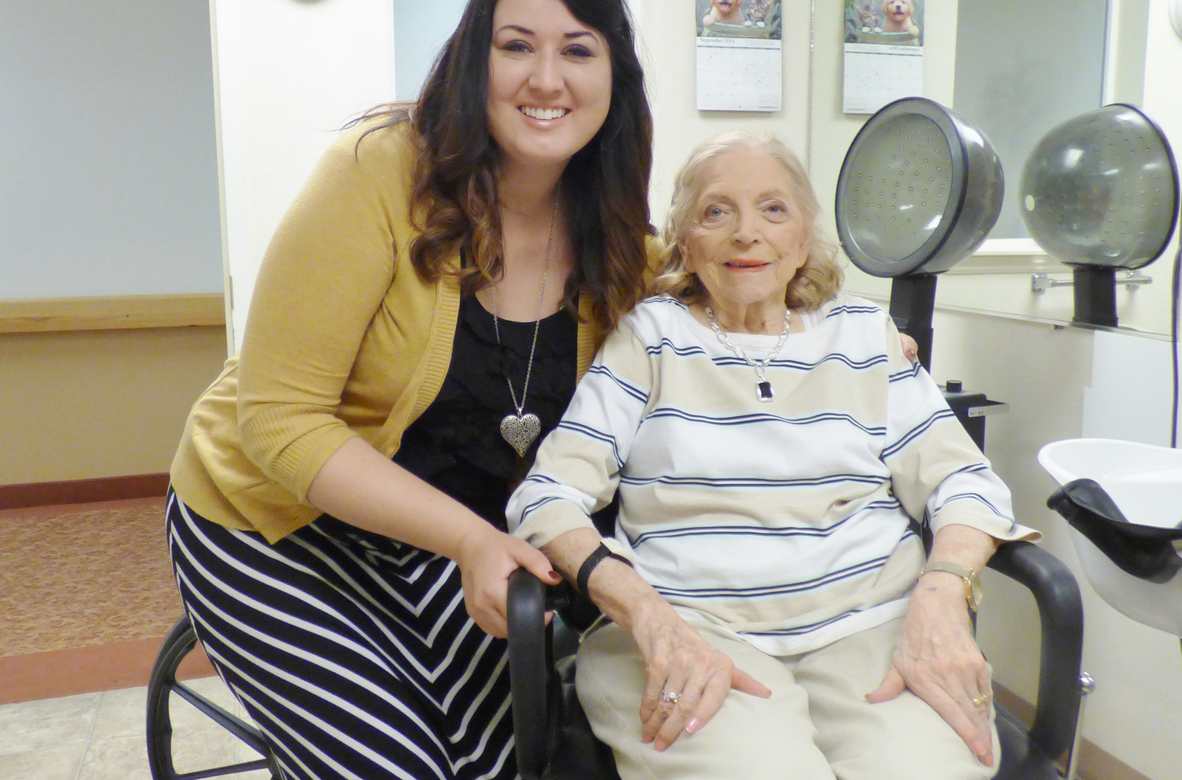
Home Palliative Care Services Salt Lake City
Facing challenges in finding home palliative care services in Salt Lake City? Solstice delivers expert care focused on comfort and dignity. Our team provides physical, emotional, and spiritual support tailored to your needs, ensuring you or your loved one receives compassionate care in a familiar, supportive environment.

Slide 6
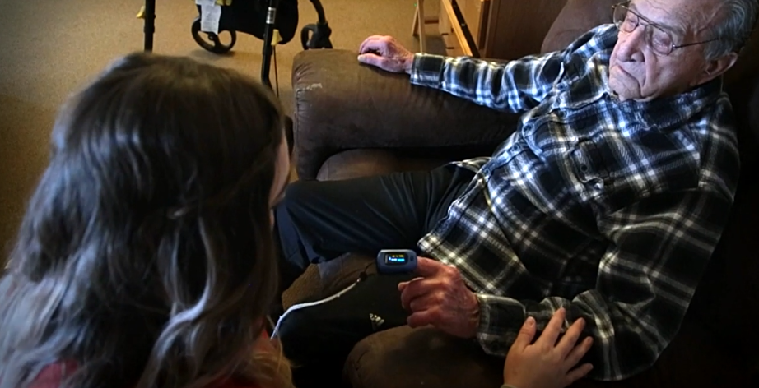
Home Health Wound Care Nurse in Utah
Searching for a home health wound care nurse in Utah? Solstice brings skilled care to your doorstep. Our nurses are experienced in wound management and provide personalized support to promote healing. We ensure you receive professional care without the need to leave the comfort of your home.

Slide 7

-:CONTACT US:-
WWW.SOLSTICEHC.COM
(801) 485-1035
1250 E. 3900 S. EAST MEDICAL TOWER SUITE 301 SALT LAKE CITY, UT 84124

